Slide 1
Chapter 3
Discrete Random Variables
and
Their Probability Distributions

Slide 2
Objectives
Discrete Distributions
Poisson Distribution

Slide 3
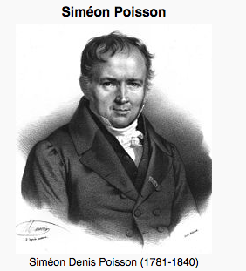
The Poisson Probability Distribution
Let the discrete random variable X denote the number of times an event occurs in an interval of time (or space).
Then X may be a Poisson random variable with x = 0, 1, 2, ...

Slide 4
Examples
Let X equal the number of typos on a printed page. (This is an example of an interval of space - the space being the printed page.)
Let X equal the number of cars passing through the intersection of two streets in one minute. (This is an example of an interval of time - the time being one minute.)
Let X equal the number of students arriving during office hours.

Slide 5
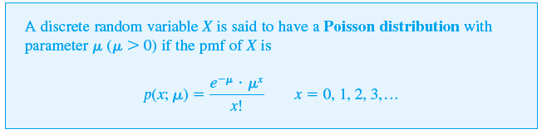
The Poisson Probability Distribution
Prove that it is a pmf.

Slide 6
Example
Let X denote the number of defects of a certain kind in a particular type of metal oxide semiconductor transistor, and suppose it has a Poisson distribution with μ = 2.
Find the probability that there are exactly three defects.
Find the probability that there are at most three defects.

Slide 7
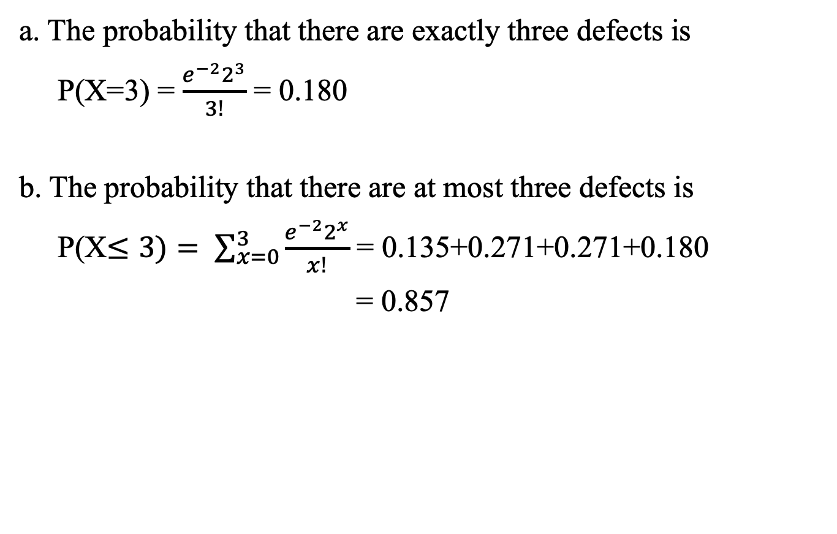
Example
a. The probability that there are exactly three defects is
P(X=3) = $\frac{e^{−2}2^{3}}{3!}$ = 0.180
b. The probability that there are at most three defects is
P(X$≤3)= \sum_{x=0}^{3}{\frac{e^{−2}2^{x}}{x!}}$ = 0.135+0.271+0.271+0.180
= 0.857

Slide 8

The Poisson Distribution as a Limit
According to this proposition, in any binomial experiment in which n is large and p is small, b(x; n, p) → p(x; μ ), where μ = np.
Prove it!
As a rule of thumb, this approximation can safely be applied if
n > 50 and np < 5.

Slide 9
Example
A publisher of nontechnical books takes great pains to ensure that its books are free of typographical errors. The probability of any given page containing at least one such error is .005 and errors are independent from page to page.
What is the probability that one of its 600-page novels will contain exactly one page with errors?
What is the probability that at most three pages with errors?

Slide 10
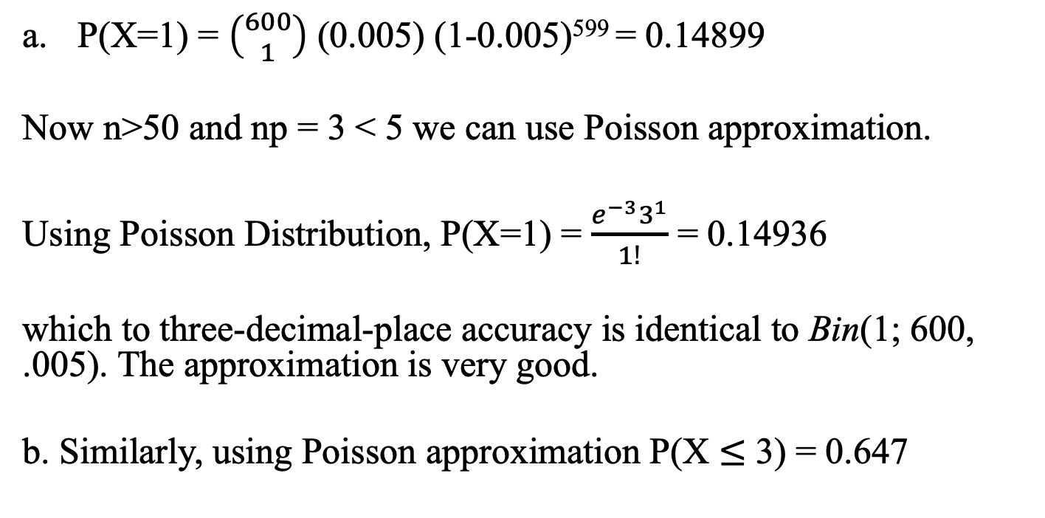
Example (cont’d)
With S denoting a page containing at least one error and F an error-free page, the number X of pages containing at least one error is a binomial rv with n = 600 and p = .005.
P(X=1) = $\left({600 \atop 1}\right)$ (0.005) (1-0.005)⁵⁹⁹ = 0.14899
Now n>50 and np = 3 < 5 we can use Poisson approximation.
Using Poisson Distribution, P(X=1) = $\frac{e^{−3}3^{1}}{1!}$ = 0.14936
which to three-decimal-place accuracy is identical to Bin(1; 600, .005). The approximation is very good.
b. Similarly, using Poisson approximation P(X $≤$ 3) = 0.647

Slide 11

The Mean and Variance of Poisson RV
Prove these!

Slide 12
The Poisson Process
A very important application of the Poisson distribution arises in connection with the occurrence of events of some type over time.
Events of interest might be
visits to a particular website
pulses of some sort recorded by a counter
email messages sent to a particular address
accidents in an industrial facility
cosmic ray showers observed by astronomers at a particular observatory

Slide 13
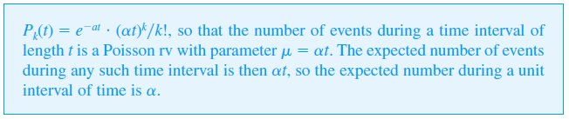
The Poisson Process
Proposition
The occurrence of events over time as described is called a Poisson process; the parameter α specifies the rate for the process.

Slide 14
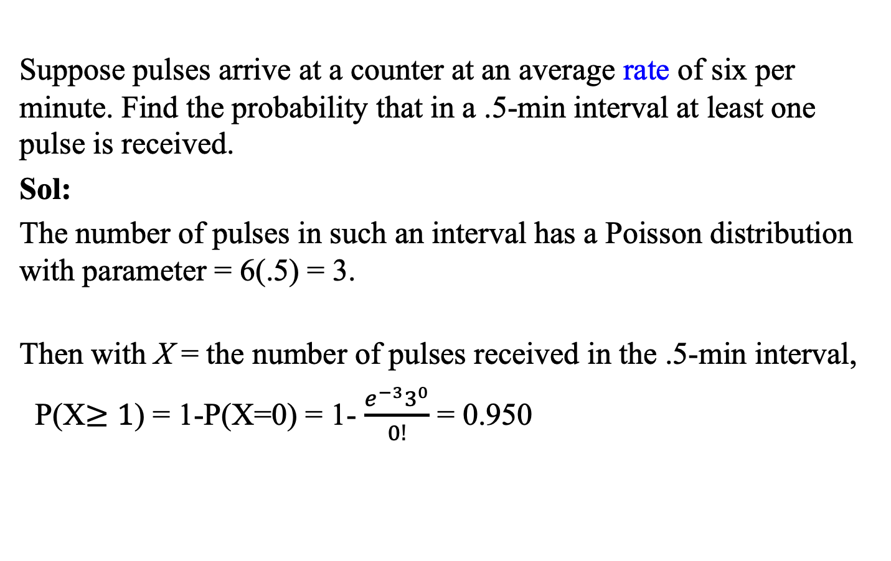
Example
Suppose pulses arrive at a counter at an average rate of six per minute. Find the probability that in a .5-min interval at least one pulse is received.
Sol:
The number of pulses in such an interval has a Poisson distribution with parameter = 6(.5) = 3.
Then with X = the number of pulses received in the .5-min interval,
P(X$≥1$) = 1-P(X=0) = 1- $\frac{e^{−3}3^{0}}{0!}$ = 0.950

